Slide 1
CSE 2217: Data Structure and Algorithms
Asymptotic notation

Slide 2
Analysis
Simplifications
Ignore actual and abstract statement costs
Order of growth is the interesting measure:
Highest-order term is what counts
Remember, we are doing asymptotic analysis
As the input size grows larger it is the high order term that dominates

Slide 3
Rate of Growth ≡Asymptotic Analysis
Using rate of growth as a measure to compare different functions implies comparing them asymptotically.
If f(x) is faster growing than g(x), then f(x) always eventually becomes larger than g(x) in the limit (for large enough values of x).

Slide 4
Example
Suppose you are designing a web site to process user data (e.g., financial records).
Suppose program A takes f_{A}(n)=30n+8 microseconds to process any n records, while program B takes f_{B}(n)=n²+1 microseconds to process the n records.
Which program would you choose, knowing you’ll want to support millions of users?

Slide 5
Visualizing Orders of Growth
On a graph, as you go to the right, a faster growing function eventually becomes larger...
f_{A}(n)=30n+8
Value of function →
f_{B}(n)=n²+1
Increasing n →

Slide 6
Asymptotic Complexity
Running time of an algorithm as a function of input size n for large n.
Expressed using only the highest-order term in the expression for the exact running time.
Instead of exact running time, say Θ(n²).
Describes behavior of function in the limit.
Written using Asymptotic Notation.

Slide 7
Asymptotic Notation
Θ, O, Ω, o, ω
Defined for functions over the natural numbers.
Ex: f(n) = Θ(n²).
Describes how f(n) grows in comparison to n².
Define a set of functions; in practice used to compare two function sizes.
The notations describe different rate-of-growth relations between the defining function and the defined set of functions.

Slide 8
Upper Bound Notation
We say InsertionSort’s run time is O(n²)
Properly we should say run time is in O(n²)
Read O as “Big-O” (you’ll also hear it as “order”)
In general a function
f(n) is O(g(n)) if there exist positive constants c and n₀ such that f(n) ≤ c ⋅ g(n) for all n ≥ n₀
Formally
O(g(n)) = { f(n): ∃ positive constants c and n₀ such that f(n) ≤ c ⋅ g(n) ∀ n ≥ n₀

Slide 9
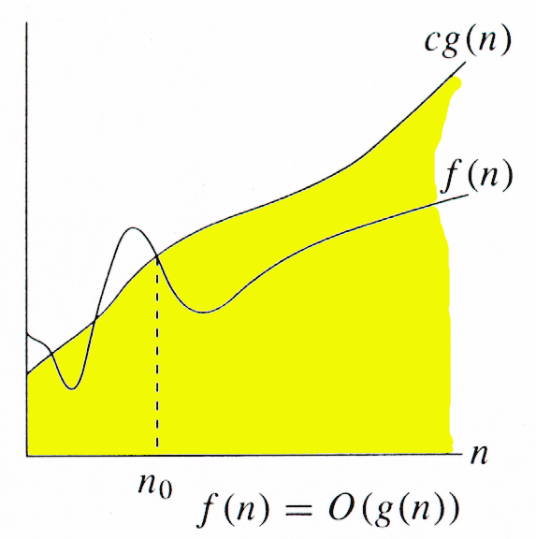
O-notation
For function g(n), we define O(g(n)), big-O of n, as the set:
O(g(n)) = {f(n) : ∃ positive constants c and n_{0,} such that ∀n ≥ n₀,
we have 0 ≤ f(n) ≤ cg(n) }
Intuitively: Set of all functions whose rate of growth is the same as or lower than that of g(n).
g(n) is an asymptotic upper bound for f(n).

Slide 10
Insertion Sort is O(n²)
Proof
The run-time is an² + bn + c
If any of a, b, and c are less than 0, replace the constant with its absolute value
an² + bn + c ≤ (a + b + c)n² + (a + b + c)n + (a + b + c)
≤ 3(a + b + c)n² for n ≥ 1
Let c’ = 3(a + b + c) and let n₀ = 1. Then
an² + bn + c ≤ c’ n² for n ≥ 1
Thus an² + bn + c = O(n²).

Slide 11
Big-O Notation
We say f_{A}(n)=30n+8 is order n, or O(n). It is, at most, roughly proportional to n.
f_{B}(n)=n²+1 is order n², or O(n²). It is, at most, roughly proportional to n².
In general, an O(n²) algorithm will be slower than O(n) algorithm.
Warning: an O(n²) function will grow faster than an O(n) function.

Slide 12
More Examples …
We say that n⁴ + 100n² + 10n + 50 is of the order of n⁴ or O(n⁴)
We say that 10n³ + 2n² is O(n³)
We say that n³ - n² is O(n³)
Even though it is correct to say “7n - 3 is O(n² )”, a better statement is “7n - 3 is O(n)”, that is, one should make the approximation as tight as possible

Slide 13
Examples
i = 0;
while (i<N) {
X=X+Y; // O(1)
result = mystery(X); // O(N), just an example...
i++; // O(1)
}
The body of the while loop: O(N)
Loop is executed: N times
N x O(N) = O(N²)

Slide 14
Examples (cont.’d)
if (i<j)
for ( i=0; i<N; i++ )
X = X+i;
else
X=0;
Max ( O(N), O(1) ) = O (N)
O(N)
O(1)

Slide 15
“Big-O” Proof Examples
Show that 30n+8 is O(n).
Show ∃c,k: 30n+8 ≤ cn, ∀n>k .
Let c=31, k=8. Assume n>k=8. Then cn = 31n = 30n + n > 30n+8, so 30n+8 < cn.
Show that n²+1 is O(n²).
Show ∃c,k: n²+1 ≤ cn², ∀n>k: .
Let c=2, k=1. Assume n>1. Then
cn² = 2n² = n²+n² > n²+1, or n²+1< cn².

Slide 16
Big-O example, graphically
Note 30n+8 isn’t less than n anywhere (n>0).
It isn’t even less than 31n everywhere.
But it is less than 31n everywhere to the right of n=8.
cn = 31n
30n+8
30n+8 ∈O(n)
Value of function →
n
n>k=8 →
Increasing n →

Slide 17
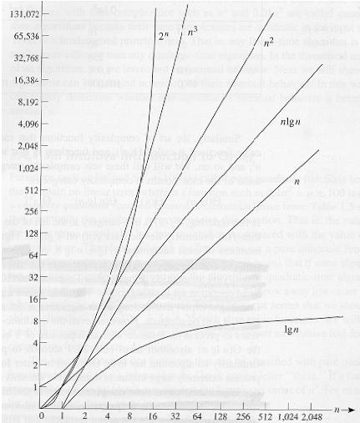
Common orders of magnitude

Slide 18
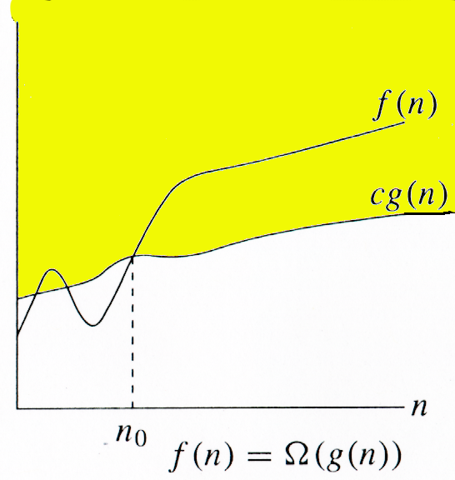
Ω -notation
For function g(n), we define Ω(g(n)), big-Omega of n, as the set:
Ω(g(n)) = {f(n) : ∃ positive constants c and n_{0,} such that ∀n ≥ n₀,
we have 0 ≤ cg(n) ≤ f(n)}
Intuitively: Set of all functions whose rate of growth is the same as or higher than that of g(n).
g(n) is an asymptotic lower bound for f(n).

Slide 19
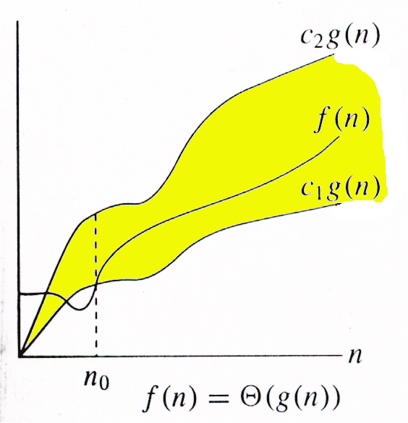
Θ-notation
For function g(n), we define Θ(g(n)), big-Theta of n, as the set:
Θ(g(n)) = {f(n) : ∃ positive constants c₁, c₂, and n_{0,} such that ∀n ≥ n₀,
we have 0 ≤ c₁g(n) ≤ f(n) ≤ c₂g(n)
}
Intuitively: Set of all functions that
have the same rate of growth as g(n).
g(n) is an asymptotically tight bound for f(n).

Slide 20
Θ-notation
For function g(n), we define Θ(g(n)), big-Theta of n, as the set:
Θ(g(n)) = {f(n) : ∃ positive constants c₁, c₂, and n_{0,} such that ∀n ≥ n₀,
we have 0 ≤ c₁g(n) ≤ f(n) ≤ c₂g(n)
}
Technically, f(n) ∈ Θ(g(n)).
f(n) and g(n) are nonnegative, for large n.
f(n) = Θ(g(n)) ⇒ f(n) = O(g(n)).
Θ(g(n)) ⊂ O(g(n)).
f(n) = Θ(g(n)) ⇒ f(n) = Ω(g(n)).
Θ(g(n)) ⊂ Ω(g(n)).

Slide 21
Asymptotic Notation in Equations
Can use asymptotic notation in equations to replace expressions containing lower-order terms.
For example,
4n³ + 3n² + 2n + 1 = 4n³ + 3n² + Θ(n)
= 4n³ + Θ(n²) = Θ(n³). How to interpret?
In equations, Θ(f(n)) always stands for an anonymous function g(n) ∈ Θ(f(n))
In the example above, Θ(n²) stands for 3n² + 2n + 1.

Slide 22
Practical Complexity
For large input sizes, constant terms are insignificant
Program A with running time T_{A}(n)= 100n
Program B with running time T_{B}(n)= 2n²
T_{P}(n)
T_{B}(n) = 2n²
T_{A}(n) = 100n
5000
Input Size n
50
Notes:
22

Slide 23
Practical Complexity
Function | Descriptor | Big-Oh
c | Constant | O( 1 )
log n | Logarithmic | O( log n )
n | Linear | O( n )
n log n | n log n | O( n log n )
n² | Quadratic | O( n² )
n³ | Cubic | O( n³ )
n^{k} | Polynomial | O( n^{k} )
2^{n} | Exponential | O( 2^{n} )
n! | Factorial | O( n! )

Slide 24
Asymptotic Notation
O notation: asymptotic “less than”:
f(n)=O(g(n)) implies: f(n) “≤” g(n)
Ω notation: asymptotic “greater than”:
f(n)= Ω (g(n)) implies: f(n) “≥” g(n)
Θ notation: asymptotic “equality”:
f(n)= Θ (g(n)) implies: f(n) “=” g(n)

